Slide 1
Regular Expressions and JS Form
Session 12
(slot 22-23)

Slide 2
Objectives
Describe regular expression
Validate data in form

Slide 3
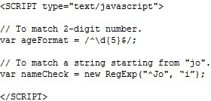
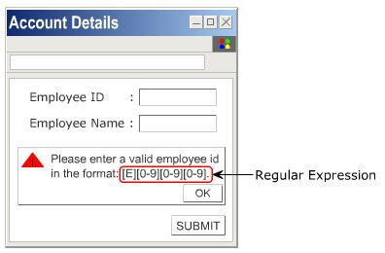
Regular Expressions
A regular expression is a pattern, whose purpose is to help in validating the text format
Example:

Slide 4
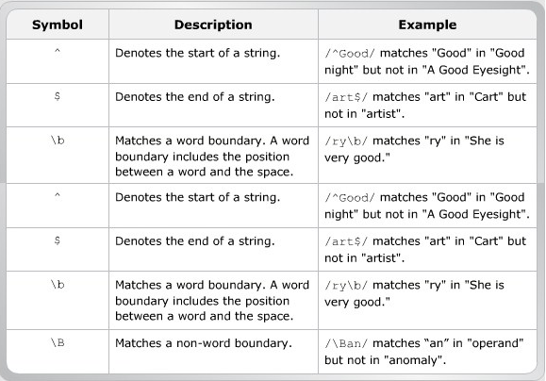
Types
Character or symbols allow matching a substring that exists at a specific position within a string.

Slide 5
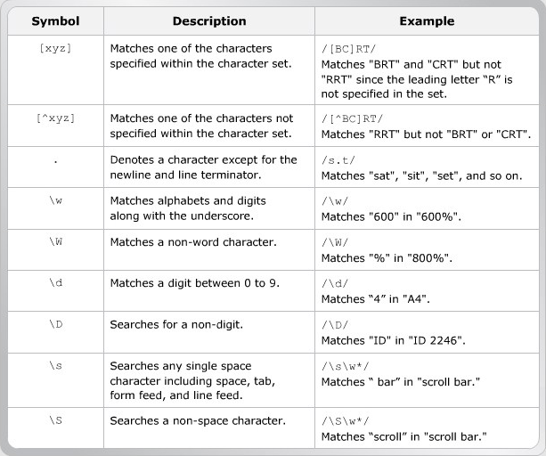
Types
Characters or symbols are combined to form character classes for specifying patterns.

Slide 6
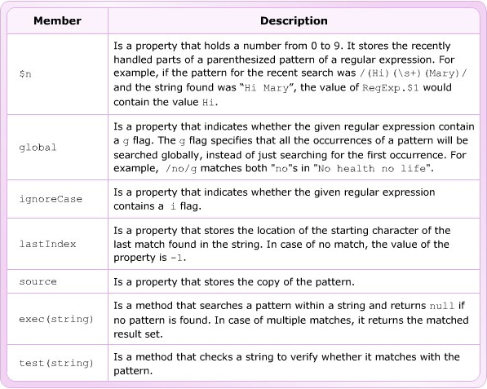
Properties and Methods

Slide 7

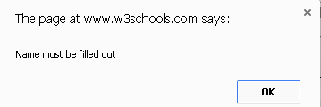
Validate data in form
Data validation is the process of ensuring that computer input is clean, correct, and useful.
Typical validation tasks are:
  has the user filled in all required fields?
  has the user entered a valid date?
  has the user entered text in a numeric field?
Data validation is to ensure correct input to a computer application.
Deployed in many different ways.
  Server side validation is performed by a web server, after input has been sent to the server.
  Client side validation is performed by a web browser, before input is sent to a web server.

Slide 8
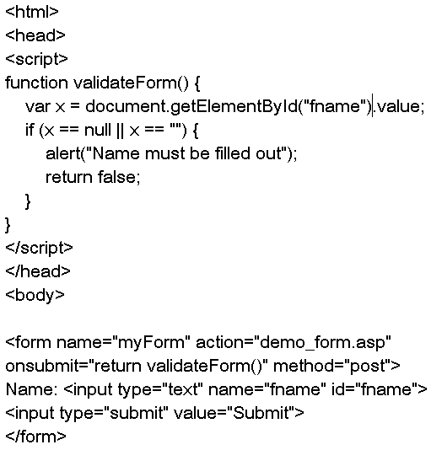
Example: check form field is empty
Can use required attribute

Slide 9
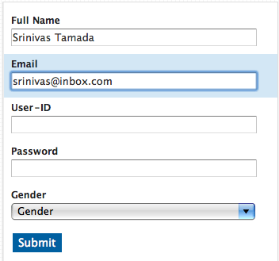
Using RegExp to check data in form

Slide 10
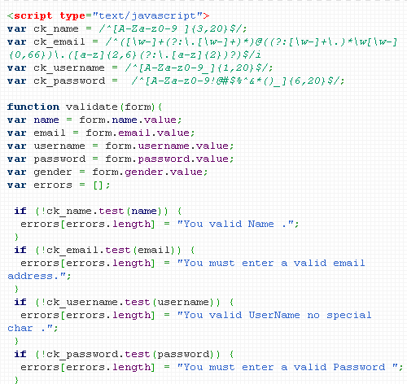
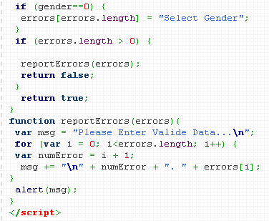
Using RegExp to check data in form

Slide 11
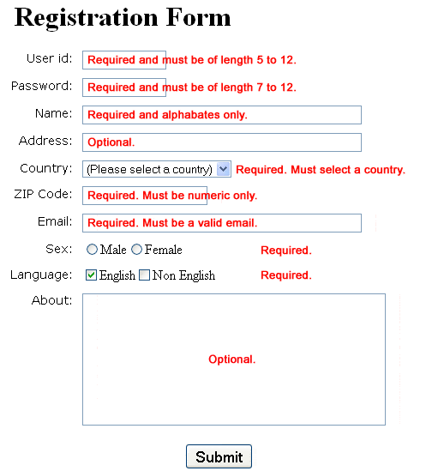
exercise

Slide 12
Summary…
A regular expression is a sequence of characters that forms a search pattern.
When you search for data in a text, you can use this search pattern to describe what you are searching for.
HTML form validation can be done by a JavaScript.

